Slide 1







Assessing the Impact of an Interactive “GPS Mission” Game on Physical Activity (Part 1)
By: Rosalie Thornton
Arizona/NASA Space Grant Statewide Symposium
Kuiper Space Sciences building
April 17th 2010

Slide 2
Acknowledgements
Nobuko (Kay) Hongu, RD, PhD- Mentor: Nutritional Sciences Extension Specialist (UA)
Barron Orr, PhD- Mentor: Arid Lands Studies (UA); Geospatial Extension Specialist
Scott Going, PhD- Professor: Nutritional Sciences Dept.
Denise Roe, DrPH- Professor and Section Chief, Biostatistics
Kristin Wisneski- Rangeland Ecology and Management Graduate Student
NPA Research Team- Martha Mosqueda, Jenna Larsen, Rebecca Reed, Nick Knutson, Bianca Teran, Kristin Gemma, & Jena Panebianco

Slide 3

Outline
1. Objective
2. Global Positioning System(GPS)
3. GPS Activities
4. Future Applications

Slide 4
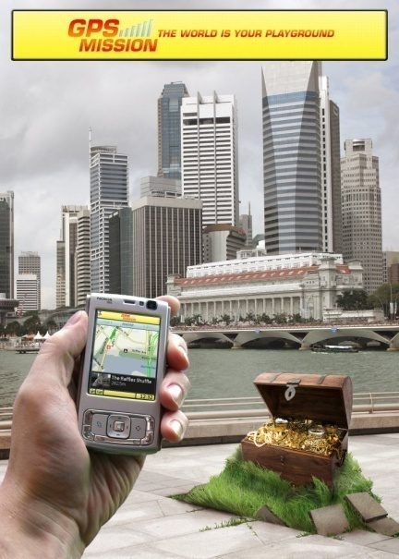
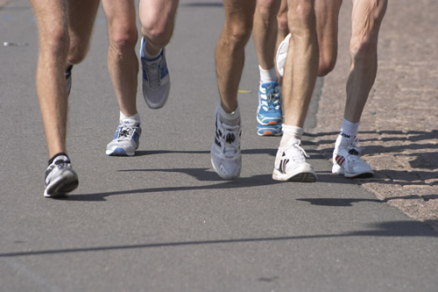
Objective
To determine if ‘GPS Mission’ will enhance
physical activity (PA) among college students
Notes:
I’m going to talk about how GPS works

Slide 5
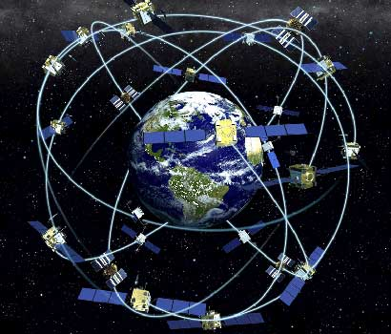
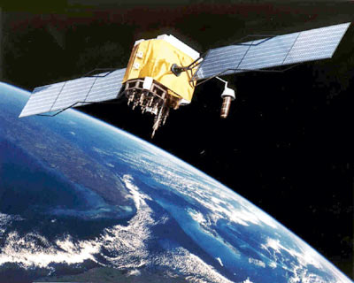
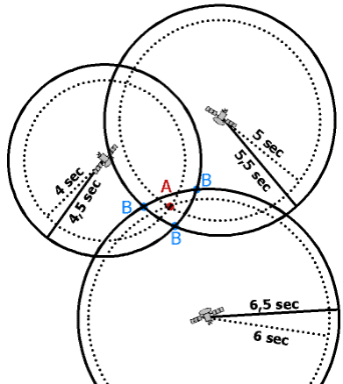
Global Positioning System (GPS)
Gives your position on earth with the information sent by satellites to the GPS receiver
Notes:
Tri-lateration- the use of more then one satellite to pin point a person’s location.

Slide 6
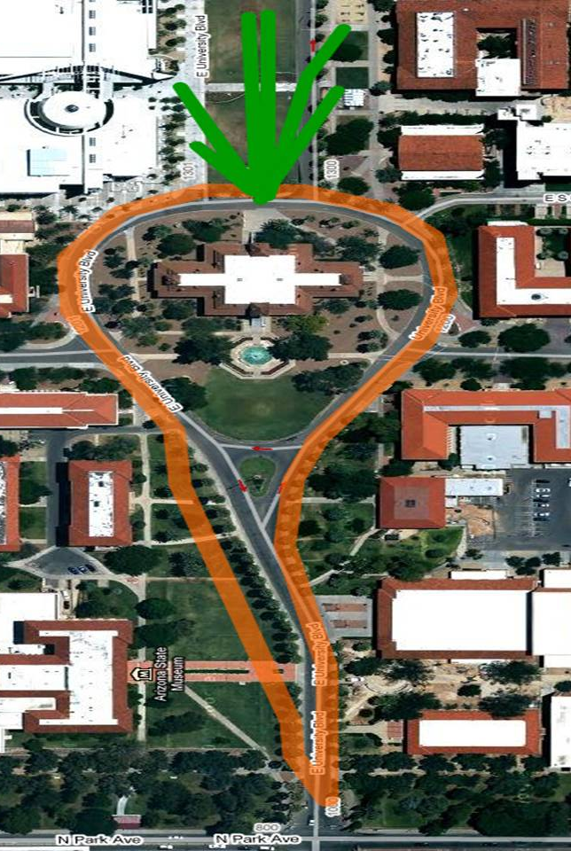
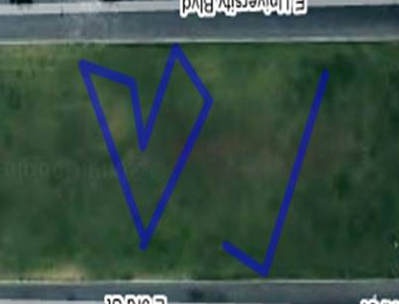
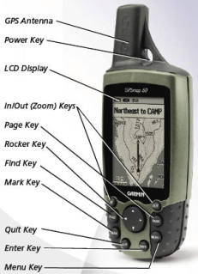

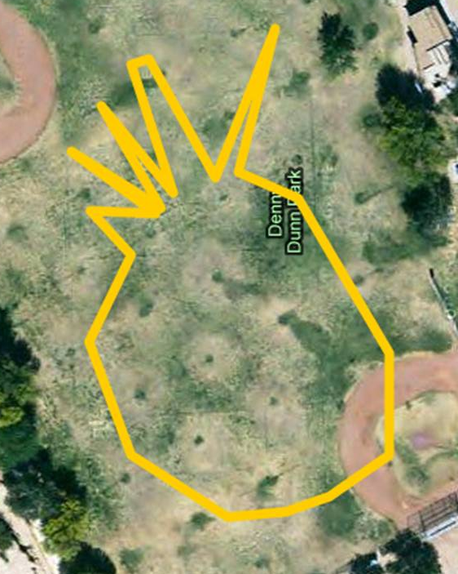


GPS Drawing
Drawing a picture on the earth’s surface by using
a GPS receiver
Notes:
Earth science and nutritional sciences

Slide 7
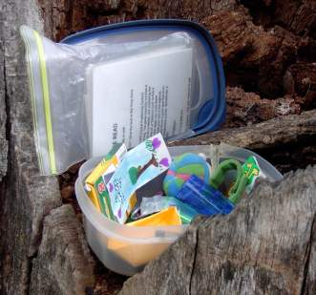
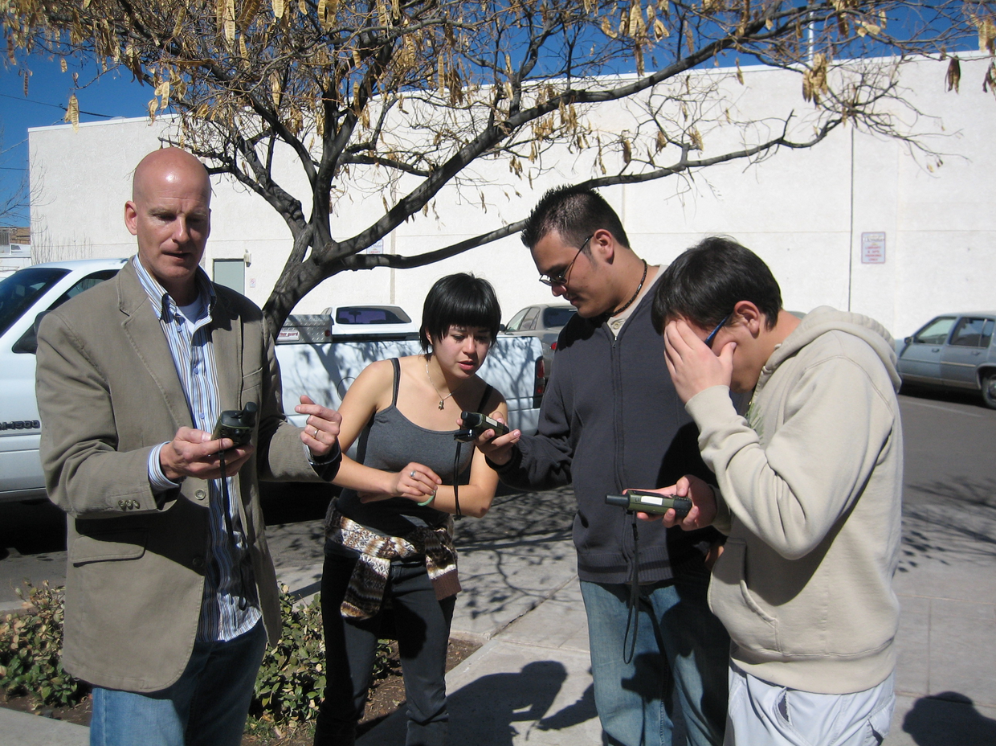
GPS Geocaching
A scavenger hunt that uses GPS as the treasure map
www.geocaching.com
Notes:
Put where you found it.

Slide 8
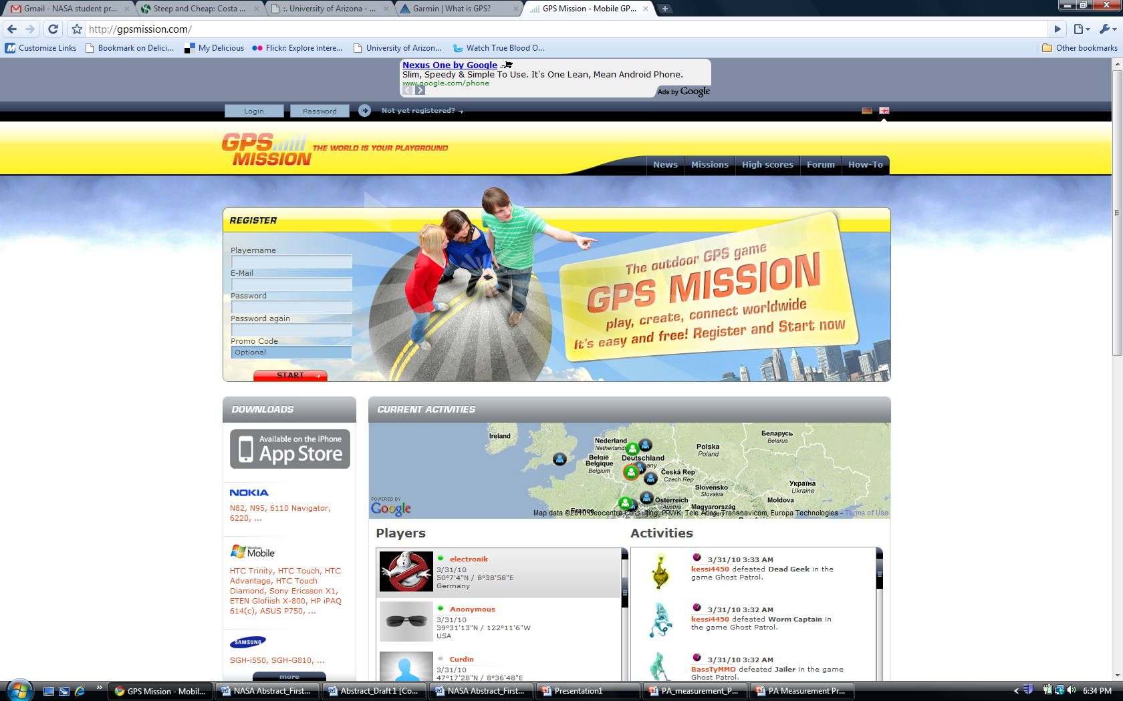
GPS Mission
‘GPS Mission’ is a
FREE smartphone
application which
requires the user
to move between
locations to reach
‘checkpoints’ and
collect virtual
gold

Slide 9
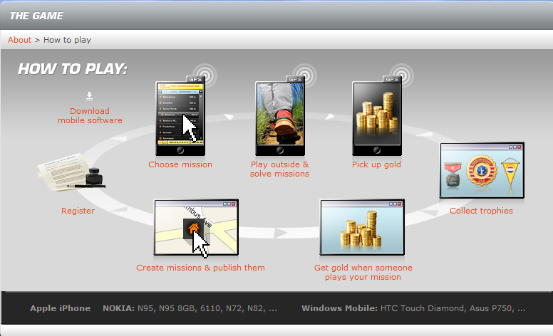
GPS Mission

Slide 10
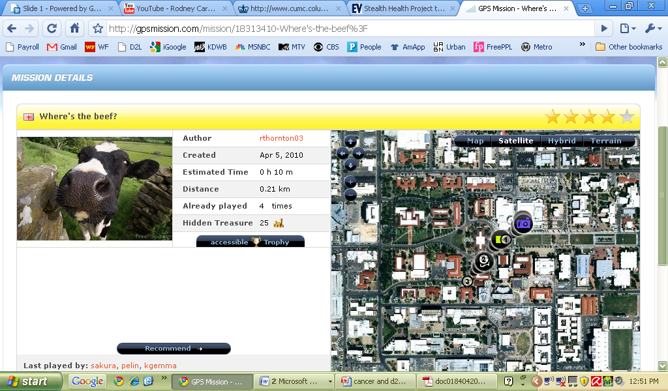
Mission

Slide 11
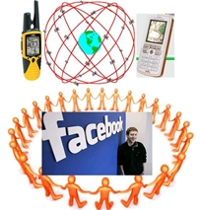
Future Applications
Stealth Health
A University of Arizona study funded by the USDA investigating how technology can stealthily increase a person’s health
Notes:
Technology MIGHT encourage increase physical activity. Jenna Larsen will talk more about our project.
Stealth health has been putting on activities for kids using GPS. A GPS makes you move to a new location.
People want to share what they have learned or done with everyone. ~ facebook and social networking
Study showing obesity as being contagious, we’re trying to make fitness contagious by facebook and social networking

Slide 12
Thank you!

